Slide 1
The History of Computers
Cameron Woolston CSIT 100

Slide 2
Introduction
Computers have become an incredibly important part of our everyday lives, controlling every part of the world and our personal lives. It is said that the average American spends 7 hours and 4 minutes looking at a screen each day, which is about ¼ of the day. This could mean scrolling on social media, doing work on the computer, looking at a screen to order food, or even a touchscreen in a car. But how did this all start? It may seem ludicrous now, but the world was once fully analog and people had to actually do math by hand, not on the calculator app. I for one could not imagine such a thing. Especially now in 2024, most kids and young people are glued to their phones, with no regard or knowledge of how they even came to be. In this paper I will be exploring how computer models developed over time, the influential figures that shaped computer science, and giving a timeline to help understand where this all fits in to history.

Slide 3
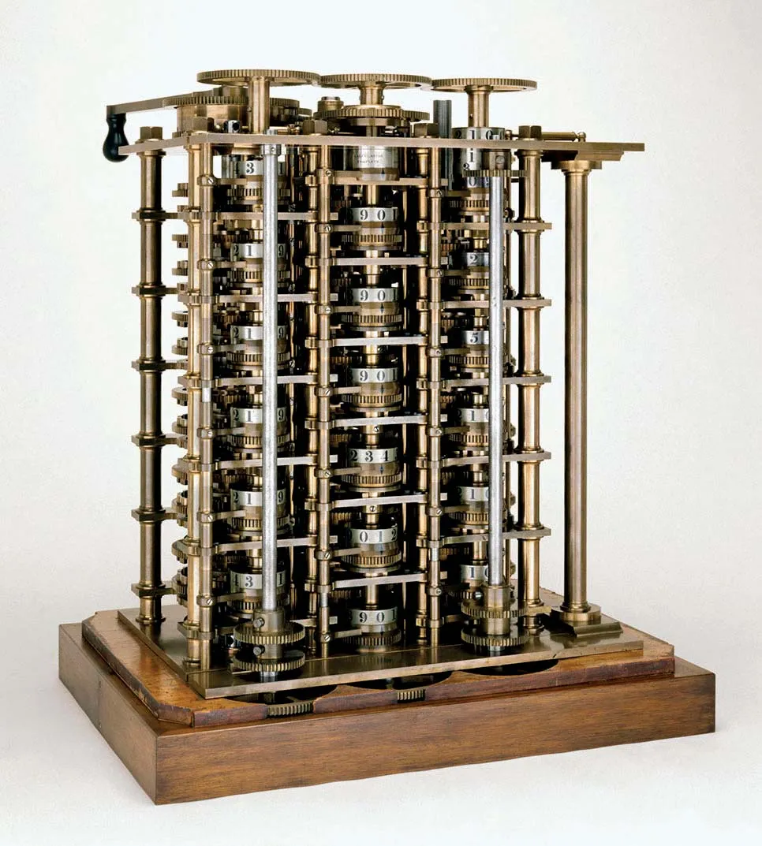
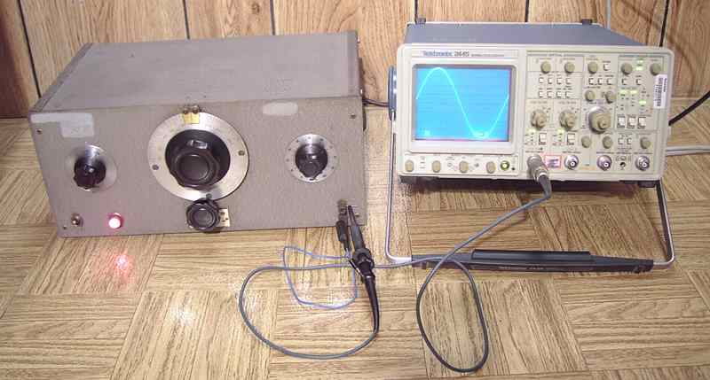
Models over Time
Charles Babbage was the first person to create the Difference Engine in the early 1820s. It was a steam powered mechanical computer that could produce basic computations. Then came along Hewlett-Packard, a company founded in a garage in California. They created the HP 200A Audio Oscillator, a very popular piece of test equipment for engineers. It even made its way to Walt Disney Pictures, where they ordered eight in order to test recording and speaker systems for their theaters that showed the sensational movie “Fantasia” in 1940.

Slide 4
Models over time - 2
In 1939, the Complex Number Calculator (CNC) was completed by the Bell Telephone Laboratories. It was designed by George Stibitz, who in 1940 demonstrated this computer at the American Mathematical Society national conference at Dartmouth University. People were in awe of his creation as it performed calculations remotely from New York City using something called a Teletype terminal connected through special telephone lines. Only a year later, Konrad Zuse in Germany finishes the Z3, a computer which uses 2,300 relays, has a 22-bit word length, and performed floating point binary arithmetic. This Z3 was used for aerodynamic calculations, but unfortunately was ruined in a bombing raid in Berlin in 1943. In the 1960s Zuse was able to reconstruct his creation, which currently resides at the Deutsches Museum in Munich.

Slide 5
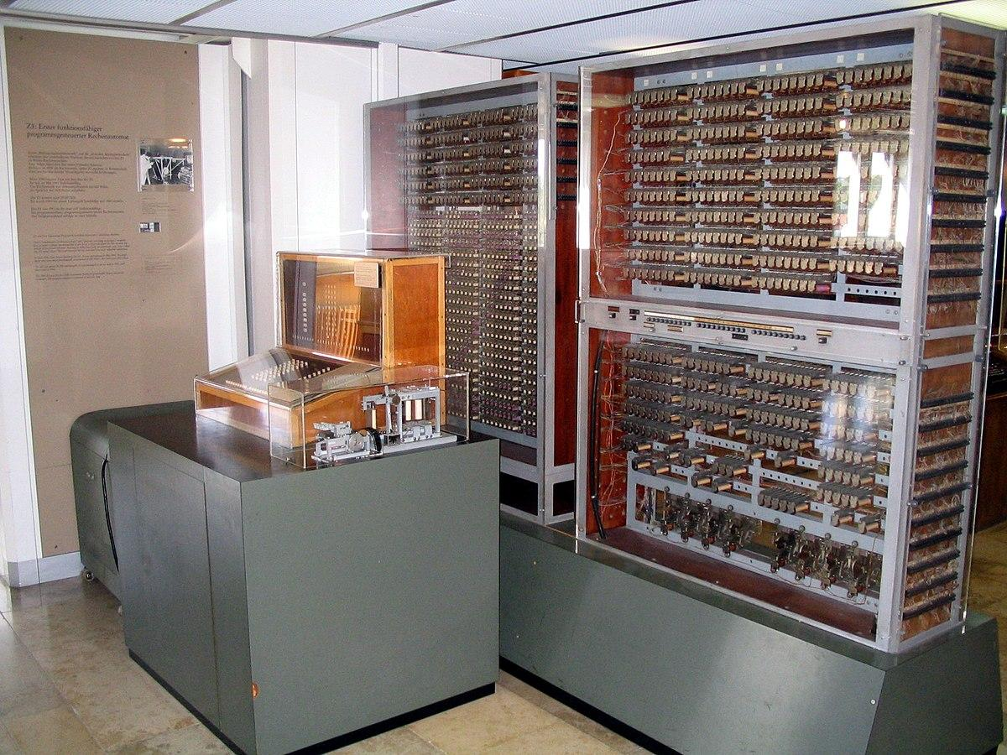
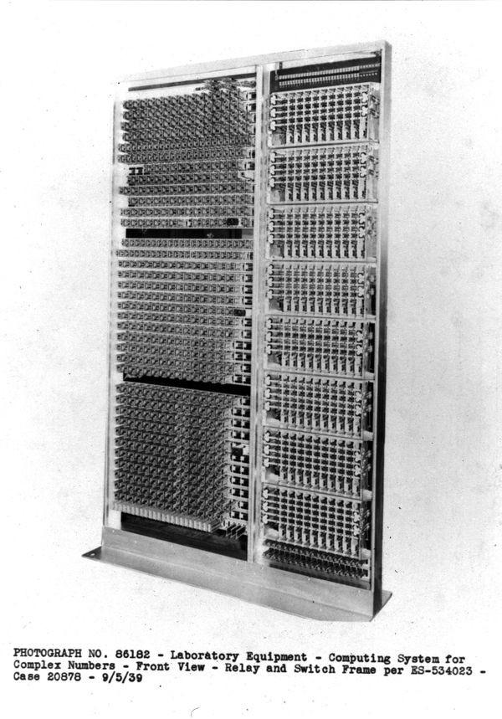
Images of CNC and Z3

Slide 6
Models over time- 3
Colossus was a computer that went into operation in 1944, and was the first large-scale electronic computer. It was used at Britain’s wartime code-breaking headquarters at Bletchley Park. Its main purpose was to decipher the messages, which were Lorenz-encrypted, between Hitler and his generals during World War II. During its time, 10 Colossus computers had been able to decrypt 63 million characters of German communications with the help of 550 people.
Another important computer was the ENIAC, also built during WWII by the U.S., and it was the first general-purpose programmable electronic digital computer. It was built by a group of physicists, engineers, and their colleagues at the Moore School of Electrical Engineering at the University of Pennsylvania. Its main purpose was to compute values for artillery range tables, doing this through plugboards and card readers.

Slide 7
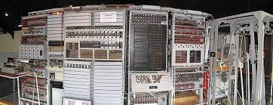
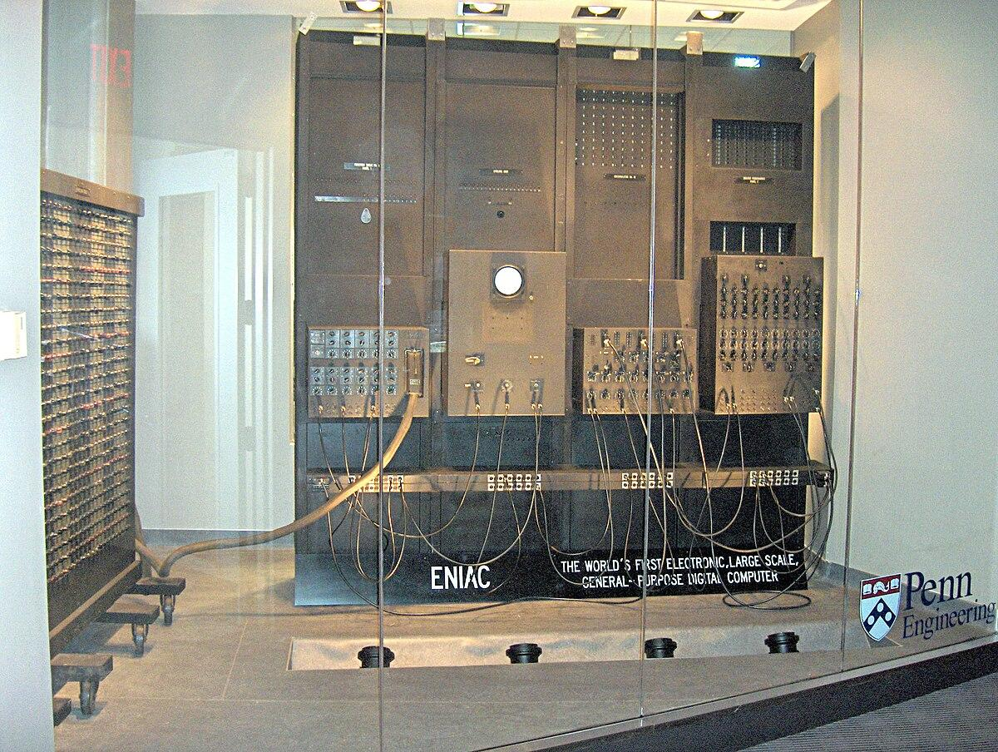
Images of Colossus and ENIAC

Slide 8
Models over time- 4
The Manchester Baby (also known as the Small Scale Experimental Machine (SSEM)) was built in 1948. It was a truly revolutionary machine, as it was fully electronic, universal, and used internal memory. It is the first computer to compare to today’s modern PCs. It consisted on 550 valves, 32 words of 32-bit memory, and and only 7 instructions. It was created by Freddie Williams and Tom Kilburn at the University of Manchester.
The next computer that made its name into the history books was the IBM System/360, which came out in 1964. It was a family of mainframe computer systems which was designed for both commercial and scientific needs. It was highly compatible and changed the way people accessed computers.

Slide 9
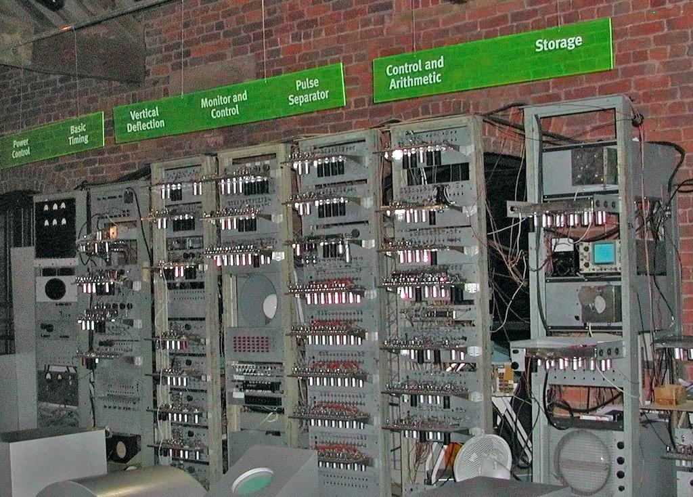
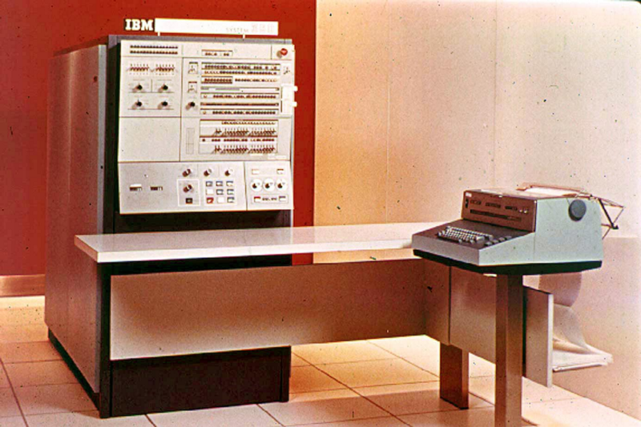
Images of SSEM and IBM System/360

Slide 10
Models over time- 5
The DEC PDP-8 revealed the issues with the past computers, the fact that they were still only available to funded government departments, universities, and wealthy corporations. Most importantly, they were extremely expensive. The DEC PDP-8 was introduced in 1965, and was the first mini-computer to sell in much higher volume, and at a much lower price. It was the size of a modern PC, not including the storage and other add-ons.
Next was the IBM PC, which took a whole 16 years after its predecessor to be put out. It overshadowed the Apple II and other great computers at the time. It was released in 1981 and directly influenced the PCs we use today. It sold for $1,565, which is about $3.900 today!

Slide 11
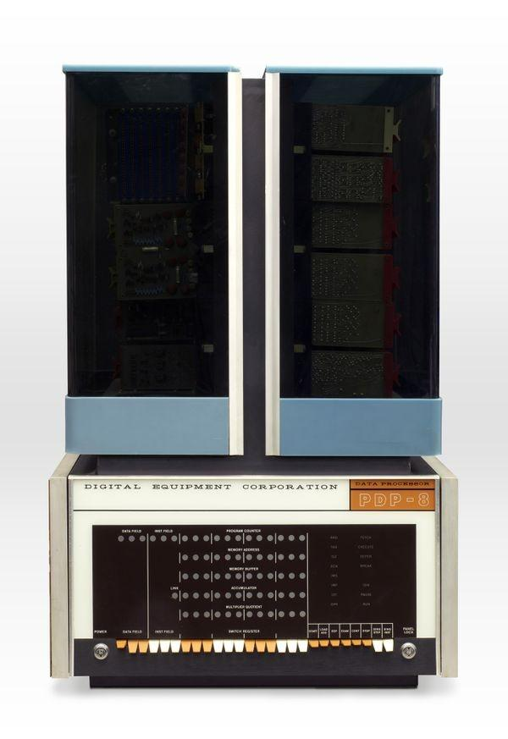
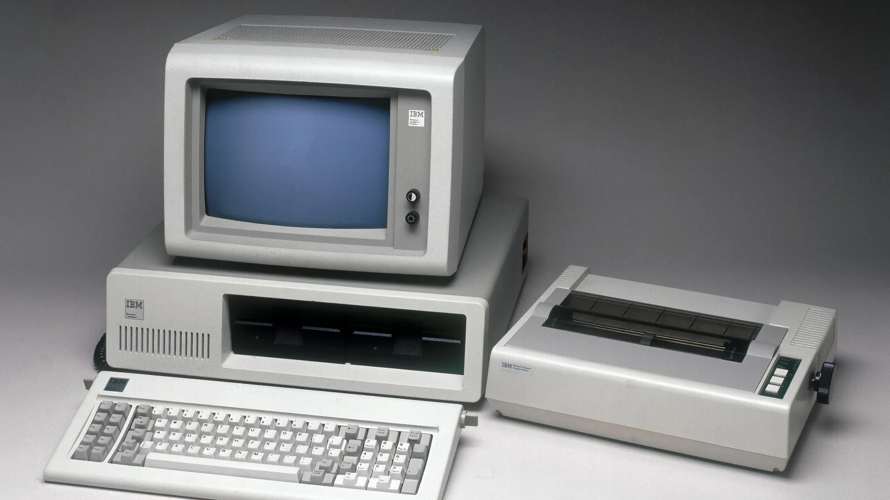
Images of DEC PDP-8 and IBM PC

Slide 12
Models over time- 6
Next was the Sinclair ZX81, which was the beginning of an influx of copycats that flooded the market, all replicating IBM. Released in 1981 and costing $75, it took over the world. It contained an 8-bit processor and featured a monochrome output to a TV set. It displayed only 24 lines of text, and used a cassette recorder for storage.
Finally, the Apple Mac came along in 1984. It was the first to use graphical icons on-screen and present information in windows on screen. It was the first mass-produced computer that was shipped alongside a mouse and graphical user interface. This was the beginning of the touchscreens and user friendly Apple products we use today.

Slide 13
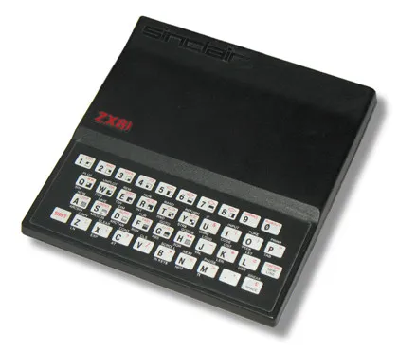
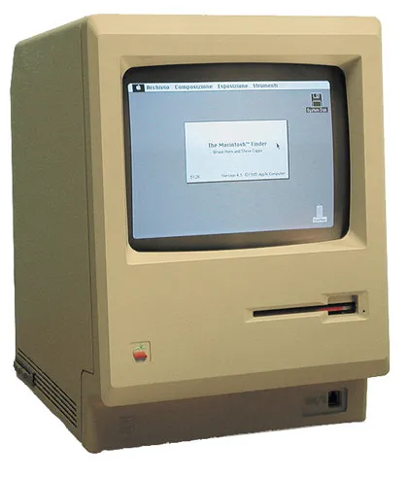
Images of the Sinclair ZX81 and Apple Mac

Slide 14
Citations
https://www.computerhistory.org/timeline/computers/
https://www.bookyourdata.com/blog/computers-changed-history
https://www.techradar.com/news/computing/the-10-most-influential-computers-in-history-707891/2

